Slide 1
CSCI 558L Lecture 2: Networking
Internetworking and Distributed Systems Laboratory
Young Cho
Department of Computer Science
University of Southern California
Slides adopted from Berkeley and Rice

Slide 2
Networking
Communication
Between Applications on different computers
Application Resource Needs/Demands
Traffic data rate
Traffic pattern (bursty or constant bit rate)
Traffic target (multipoint or single destination, mobile or fixed)
Delay sensitivity
Loss sensitivity
Notes:
Some example applications: video, audio, telnet, ftp, http, rpc – what are their needs

Slide 3




Back in the Old Days…

Slide 4




Packet Switching (Internet)
Packets

Slide 5
Packet Switching
Interleave packets from different sources
Efficient: resources used on demand
Statistical multiplexing
General
Multiple types of applications
Accommodates bursty traffic
Addition of queues

Slide 6
Characteristics of Packet Switching
Store and forward
Packets are self contained units
Can use alternate paths – reordering
Contention
Congestion
Delay

Slide 7
Internet[work]
A collection of interconnected networks
Host: network endpoints (computer, PDA, light switch, …)
Router: node that connects networks
Internet vs. internet
Internet[work]
Notes:
What if want to communicate between hosts on different Ethernets? Internet as interoperability layer

Slide 8
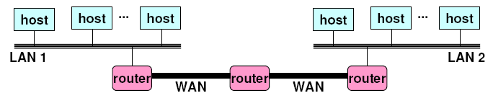
Internet
Heterogeneous Computer Networks
Physical connection via routers and switches
Largest Conglomeration of Such Networks
LAN 1 and LAN 2 might be completely different,
totally incompatible LANs (e.g., Ethernet and WiFi,
802.11*, T1-links, DSL, …)

Slide 9
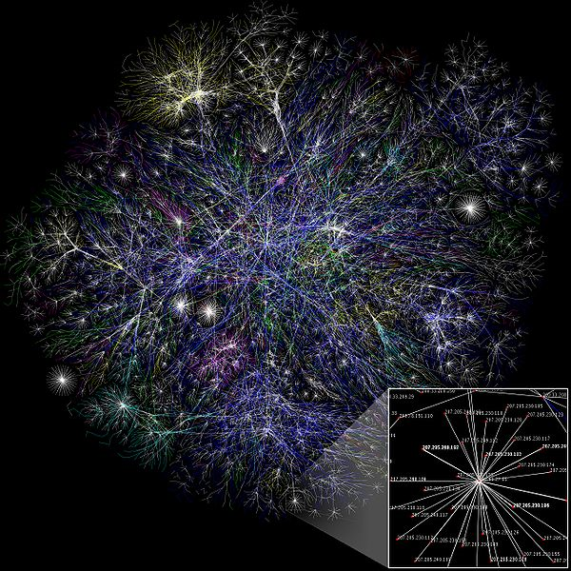
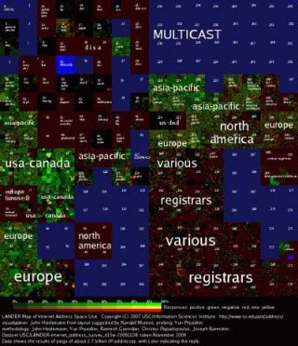
Internet
Maps of the Internet

Slide 10
Challenge
Many differences between networks
Address formats
Performance – bandwidth/latency
Packet size
Loss rate/pattern/handling
Routing
How to translate between various network technologies?

Slide 11
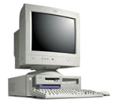
How To Find Nodes?
Internet
Computer 1
Computer 2
Need naming and routing

Slide 12
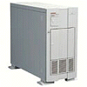
Naming
What’s the IP address for www.usc.edu?
It is 128.125.253.136
Computer 1
Local DNS Server
Translates human readable names to logical endpoints

Slide 13
Routing
Routers send packet towards destination
H
R
H
H
R
R
R
R
R
H
R
H: Hosts
R: Routers
R
H

Slide 14
Meeting Application Demands
Reliability
Corruption
Lost packets
Flow and congestion control
Fragmentation
In-order delivery
Etc…

Slide 15
Data Corruption
Problem: Data Corruption
GET index.html
GET windex.html
Internet
Solution: Add a checksum
X
0,9
9
6,7,8
21
4,5
7
1,2,3
6

Slide 16
Bandwidth Bottleneck
Problem: Network Overload
Solution: Buffering and Congestion Control
Short bursts: buffer
What if buffer overflows?
Packets dropped
Sender adjusts rate until load = resources → “congestion control”

Slide 17
Lost Packets
Problem: Lost Data
GET index.html
Internet
Solution: Timeout and Retransmit
GET index.html
GET index.html
Internet
GET index.html

Slide 18
Large Data
Problem: Packet size
On Ethernet, max IP packet is 1.5kbytes
Typical web page is 10kbytes
Solution: Fragment data across packets
ml
x.ht
inde
GET
GET index.html

Slide 19
Out of Order Packets
Problem: Out of Order
ml
inde
x.ht
GET
GET x.htindeml
Solution: Add Sequence Numbers
ml
4
inde
2
x.ht
3
GET
1
GET index.html

Slide 20
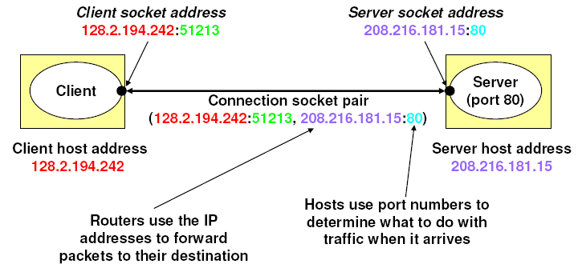
An Internet Connection

Slide 21
Lots of Functions Needed
Link
Multiplexing
Routing
Addressing/naming (locating peers)
Reliability
Flow control
Fragmentation
Etc….

Slide 22
What is Layering?
Modular approach to network functionality
Example:
Application
Application-to-application channels
Host-to-host connectivity
Link hardware

Slide 23
Protocols
Module in layered structure
Set of rules governing communication
Applications
Hosts
Routers
Protocols define:
Interface to higher layers (API)
Interface to peer
Format and order of messages
Actions taken on receipt of a message
Notes:
Human analogy – social customs

Slide 24
Layering Characteristics
Services
Each layer relies on services from layer below
Each layer exports services to layer above
Provides interface that defines interaction
Modularity
Hides implementation
Layers can change without disturbing other layers (black box)

Slide 25
Layering
User A
User B
Application
Transport
Network
Link
Host
Host
Layering: technique to simplify complex systems

Slide 26
OSI Model: 7 Protocol Layers
Physical: how to transmit bits
Data link: how to transmit frames
Network: how to route packets
Transport: how to send packets end2end
Session: how to tie flows together
Presentation: byte ordering, security
Application: everything else

Slide 27
OSI Layers and Locations
Application
Presentation
Session
Transport
Network
Data Link
Physical
Host
Switch
Router
Host

Slide 28
Layer Encapsulation
User A
User B
Get index.html
Connection ID
Source/Destination
Link Address

Slide 29
Remnants of Layering
Redundancy
Layer N may duplicate lower level functionality (e.g., error recovery)
Layers may need same info (timestamp, MTU)
Consequences
For assurance and guarantee
May hurt performance

Slide 30
Conclusion
Beginnings of Internet
Purpose is to provide robust, scalable, and effective network
Theoretical foundations for packet networks in 1962: Kleinrock
Hierarchical routing in 1970’s : Kleinrock
ARPANET connecting UCLA and SRI on Oct 29, 1969
The rest is a complex web of history (w/ many proclaimed fathers)
Conclusion: it works pretty well!
Internet Governance
USC – Information Sciences Institute
Internet Corporation for Assigned Names and Numbers
ICANN assigns unique identifiers for use on the Internet
including domain names, Internet Protocol (IP) addresses, application port numbers in the transport protocols, and many other parameters

Slide 31
Next
Next Lecture: Ethernet and IP
Projects
Team sign-up sheet
Working on the Emulab Tutorials
Reading Assignment:
The DARPA Internet Protocol Suite
Slides and Q&A
Students Added and Dropped

